Slide 1
OS Overview
Operating System Lab-in-a-Box
Notes:
This course presents Operating Overview for Lab-in-a-Box

Slide 2
OS Components
Process management
How to run a program?
How to allocate resources?
Memory management
Memory allocation
Protection
Virtual memory
File systems
Secondary storage
I/O
Device Drivers
Network
Security
GUI
Notes:
The OS components include: Process management, memory management, file system management, I/O management, networking, security and graphical user interface management.

Slide 3
Process
Operating system deals with various kind of activities – process
User applications and system applications
Abstracted as process - all the execution context
An instance of a running program – possible to have multiple processes running the same program at the same time
Independent memory space
Creation and destruction
Schedule
Communication
Concurrency
Notes:
Various activities or sub programs are called processes. The operating system’s processes include user and system applications. For each process, the OS maintains execution context. Multiple processes may be running the same library or sub program at the same time. Each process has independent memory space. The operating system creates and deletes the processes, it also schedules the processes depending on their deadline, priority, sequence etc. Furthermore, the operating system helps in maintaining communication and concurrency of processes.

Slide 4
Memory
How to organize processes’ memory
Programs are stored in memory as well as data
Multiprogramming supports
Sharing data between processes
Pages
Virtual memory – use the secondary memory, RAM as a cache
Notes:
Each process needs memory space and it is the job of the operating system to organize the memory for each process. Virtual memory concepts hides limitations or size of the primary memory. The memory looks to be infinite for the applications.
The memory does organize the memory in a hierarchical way which consists of a cache, primary memory, and secondary memory.

Slide 5
Files and I/O
File – an abstraction of a bulk of information
Secondary storage
Standard operations such as create, delete, copy and paste
Advanced, searching, backup and so on
I/O
As shown in the previous example
Requires device-specific knowledge
Device drivers and standard interface
Notes:
Operating systems control the actions on files which are in secondary memory and also the I/O operations.

Slide 6
Operating System Structure
Different components interact with each other
Not so straightforward as to how to organize all the components
A challenging software engineering problem
Reliability
Backwards compatibility
Extensibility
Portability
Notes:
The operating system manages the operations and interactions between various components and provides reliability, compatibility, extensibility, and portability.

Slide 7
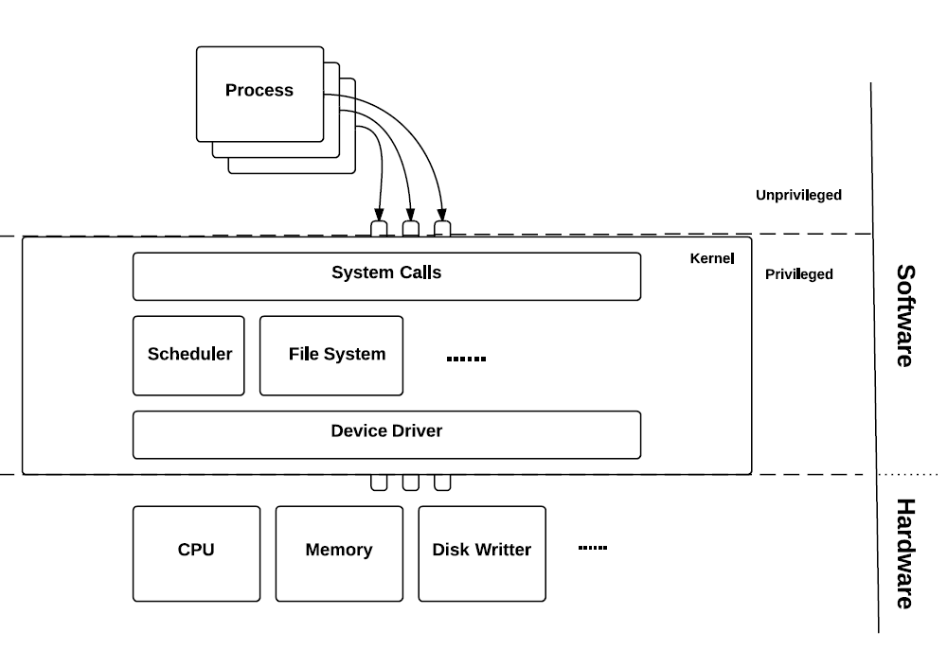
Monolithic
Traditional OS structure
Single program includes all kernel code and offers all OS services
System calls
Fast and efficient
Less portable and difficult to maintain
Minor bugs can crash the entire system!
Unix and Unix-like OSs
Linux with loadable modules
Notes:
A monolithic kernel has a simple design, it runs in a single address space and is a large process. It is a single static binary file and all kernel services exist and execute in kernel address space. The kernel can invoke functions directly. Some examples of monolithic kernel based OSs include Linux and Unix.

Slide 8
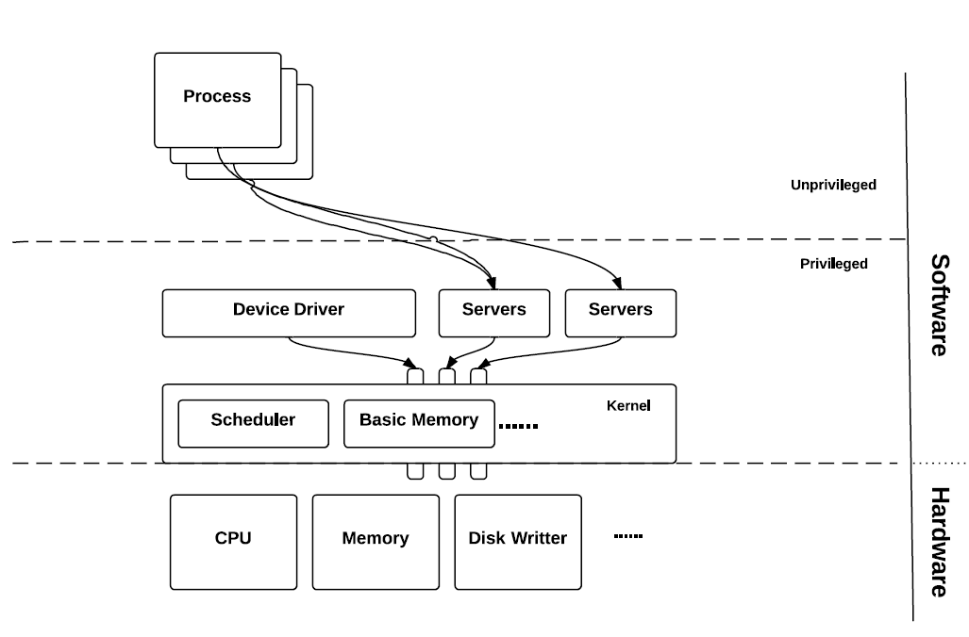
Microkernel
Minimal Kernel
Kernel design is simplified (privilege modes only)
User-space servers (may be privileged but usually unprivileged)
Rapid development, unit testing, easy maintenance
Huge memory footprint
Frequent context switching and inter-process communication
Not easy to implement
Notes:
In Microkernels, the kernel design is simple and the kernel is broken down into separate processes, known as servers. These “server” are run in kernel space or in user-space. All servers are kept separate and they run in separate address spaces. Microkernels have the ability to communicate by message passing while the servers communicate through IPC (Inter-process Communication). Servers invoke "services" from each other by sending these messages, even if one server fails another server can still work efficiently. Advantages are rapid development and testing, also it is easy to maintain. However the downsides are that they occupy huge amounts of memory, require frequent context switches and inter-process communication. The example of microkernel based OS are QNX, L4 and HURD. Hybrid kernels are Mac OS X and Windows.

Slide 9
Operating System Structure
Monolithic has better performance in general
Microkernels have better modularity and extensibility
Price for switching between modes is high
Modern OSs (most commercial) adopt a hybrid approach
The kernel is kept as small as possible
But most servers are in the privileged kernel space
Windows NT
XNU (OS X)
Notes:
The monolithic kernels are easy to design and faster but micro kernels are modular and scalable, however they are a bit slower than monolithic kernels.
Mac OS and Windows use hybrid kernels. The hybrid kernel combines concepts of the microkernel and the monolithic kernel architecture.

Slide 10
Types of Operating Systems
Network operating system
OS for computer networks
Allows and facilitates file sharing and hardware access
For local area networks (commonly seen in enterprise environments)
More features than the single computer OS: more communication
Routers OS (Cisco IOS)
Peer-to-peer
Manager and subordinate network
Structure depends on the topology of the network
Notes:
Types of OS are: Network OS, Distributed OS, RTOS, Embedded OS etc.
A network operating system is for network devices such as switches, routers, or firewalls and it helps in sharing files between networked computers and printing. It provides security and sharing data between members in a group. This is good for local area networks (LAN). It helps in communications using peer to peer or manager and subordinate concepts. Current operating systems also provide these functions.

Slide 11
Types of Operating Systems
Distributed Operating Systems
Each node carries a “Horcrux ” – microkernel plus service components that coordinates with other nodes
Work collectively to fulfil all functions of an OS
Single node has full access to all system resources
Complicated scheduling and parallelism
User may not be aware of which specific node is executing the program or where the physical location of the file is – all automatically handled by the OS
Notes:
Distributed operating systems run on multiple nodes in a computer network. Each node may run a microkernel with communication features. The distributed operating system works collectively to serve all the functions of an operating system. The user does not need to know in which node his program is working or where the physical location of his file is. All these functions are handled by the OS.

Slide 12
Types of Operating Systems
RTOS
Real-time operating system dedicated to meeting specific timing constraints
Two types: hard real-time (ensures the critical tasks are to be completed on time) and soft real-time (if the deadline is not met, it is still worth finishing the task)
Industrial applications: robots, aircraft control …
Key design requirements:
Predictability and determinism
Speed is practically important. Usually achieved via a simplified OS design and sometimes traded off for predictability and determinism
Responsiveness and user control: do the right thing fast enough and priorities can be dynamically adjusted by users
Fail-safety: sometimes simply shutting down everything may not be a good option
Demands advanced scheduling and memory allocation
Notes:
The main task of real time operating system (RTOS), is to maintain the timing requirements of the application program. The application program may have many tasks to complete and compute within a specific time. Each task may have a different dead line to meet. RTOS makes sure that all the tasks are scheduled in the right order and time so that the dead lines are met for each task.
The tasks can have a “hard” real time dead line or “soft” real time deadline. A hard dead line means that the deadline should be met otherwise there will be catastrophic effect. Example: Controlling air craft engine speed.
A soft real time task allows for a few dead line misses. Even if the task does not meet the dead line, it is ok. Example: Getting data from internet.
RTOS’s key requirements are predictability and determinism. This means that the execution time of each hard real time task should be predictable and it should be exact. RTOS is simple so that the speed of execution is high. RTOS should respond to user control fast and it should be fail safe. RTOS provides advanced scheduling and memory allocation to meet the requirements of the system.

Slide 13
Embedded Operating Systems
RTOS and EOS are not exactly the same thing, but most EOSs are RTOSs, and aim at meeting the same timing constrains, therefore interchangeable in this course
Predictability and determinism again
Major scheduling algorithms based on predicting the upper bound of the execution time
Interrupts
“Real-Time”
Unified understanding of the deadline
Precise time services: TAI, UTC
Fast, everything sits on the real-time kernel, even device driver
What might not be important?
GUI?
Security? Depends on the application
Notes:
Embedded operating systems (EOS) are real time operating systems. EOS are a subset of RTOS to run on limited memory space and computing power of the embedded processor/board. EOS must provide predictability and determinism, and meet the dead lines of tasks that are hard real time tasks. EOS should also be fast and sit on a real time kernel and device driver. A device driver is a program that can control a printer, display or input/output device, they are part of the EOS. A graphical user interface for an EOS need not be done in real time or it may not be important depending on the application.

Slide 14
RTOS on Embedded System vs. Super Loop
Super-Loop is straightforward to implement and fits the computational model of ES
Depends on lengthy interrupt service routine (ISR)
Needs to keep the synchronization between ISRs
Poor predictability (nested ISRs) and extensibility
Change of the ISR or the Super-Loop ripples through entire system
RTOS: all computation requests are encapsulated into tasks and scheduled based on the demand
Better program flow and event response
(Illusionary) multitasking
Concise ISRs thus deterministic
Better communication
Better resource management
Notes:
Embedded systems can have an RTOS or a “Super Loop” programming environment. Super-loop involves straight forward programs with no OS. Here, the interrupt service routines (ISR) may be lengthy. Poor predictability of ISR and difficulty to extend or scale the ISR are characteristics of Super-loop.
RTOS provides a better program flow and event/task response. RTOS allows multitasking, deterministic ISR, better communication and better resource management for sharing between various tasks.

Slide 15
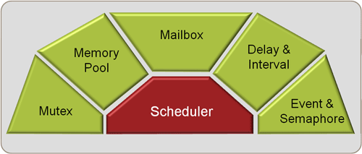
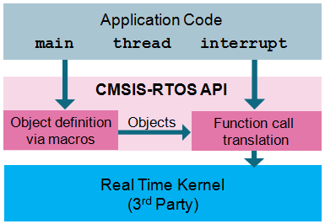
RTOS for this Course
Keil RTX
Support ARM Cortex-M cores
Well-rounded RTOS for ES
Scheduler/ Mutex/ Event/ Semaphore/ Mailbox…
CMSIS-RTOS API
Generic RTOS interface
CMSIS RTOS for ST is based on Keil RTX
Utilise some Cortex-M instructions
RTX Structure
CMSIS-RTOS API Structure
Notes:
In this course we will look at two RTOSs, namely Keil RTX and CMSIS-RTOS-API.
Keil RTX is a Real-Time Operating System for ARM and the Cortex-M devices.
The CMSIS-RTOS API is a generic RTOS interface for ARM® Cortex®-M processor-based systems. It provides RTOS functionality.
We will see more details of them in later modules.

Slide 16
Next
Processes
Notes:
The next module is on processes.

